Slide 1
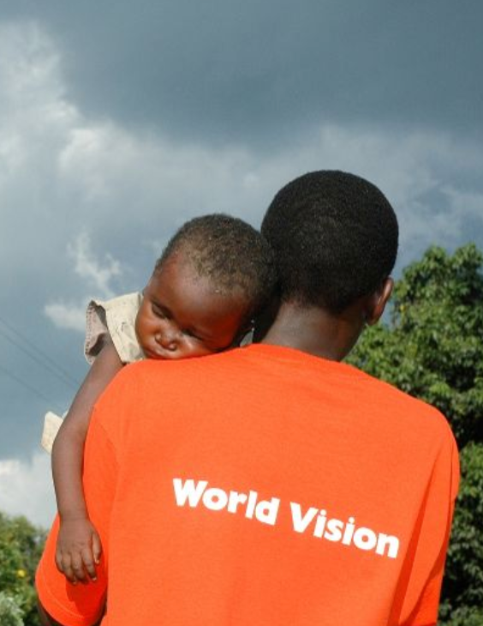







Declining donor engagement and donation rates in the recent years visible via channels and segments.
Supporter Engagement Diagnosis of
World Vision’s Bounceback Campaign
Understanding the root causes behind poor engagement using data diagnostics.

Slide 2





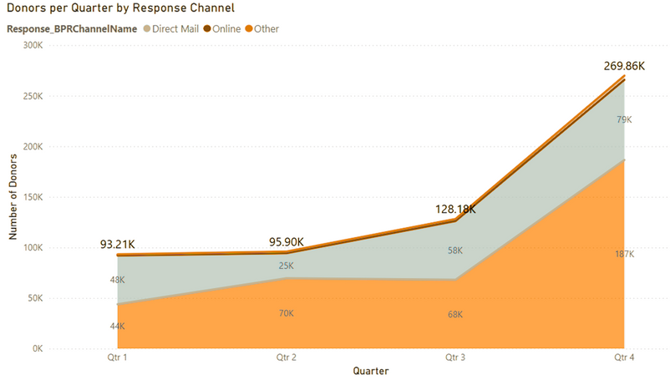
1
Diagnostic Review: Purpose and Aim
2
3
Declining donor engagement and donation rates in the recent years visible via channels and segments.
4
5
6
Understanding the root causes behind poor engagement using data diagnostics.

Slide 3
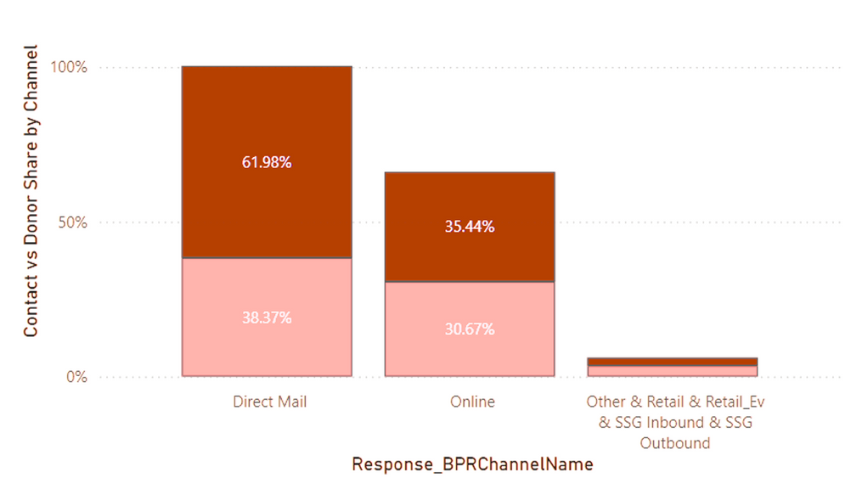
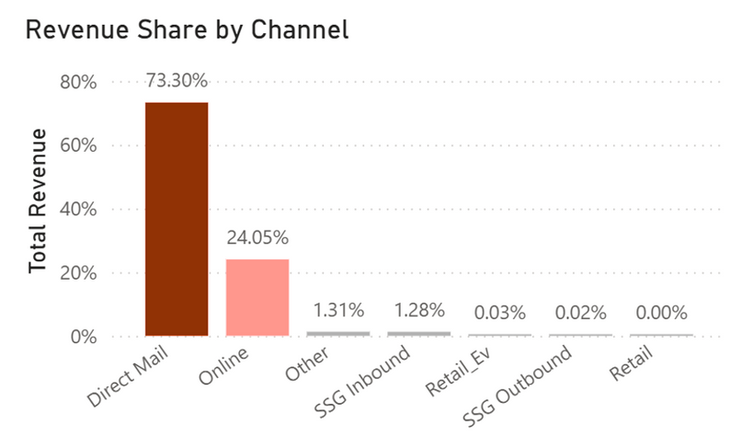
Evolving Trends in Donor Engagement Across Channels
1
2
Direct Mail fluctuates yearly—dropping from 48K in Q1 to 25K in Q2, then rising to 79K in Q4. Still, it lags behind Online, which peaks at 187K donors in Q4.
3
4
5
Online channel grows significantly from ~44K in Q1 to 187K in Q4, showing a strong seasonal surge, likely driven by Birthday and Christmas campaigns.
6
Other channels remain flat and minimal (<5 K per quarter), indicating limited reach.

Slide 4
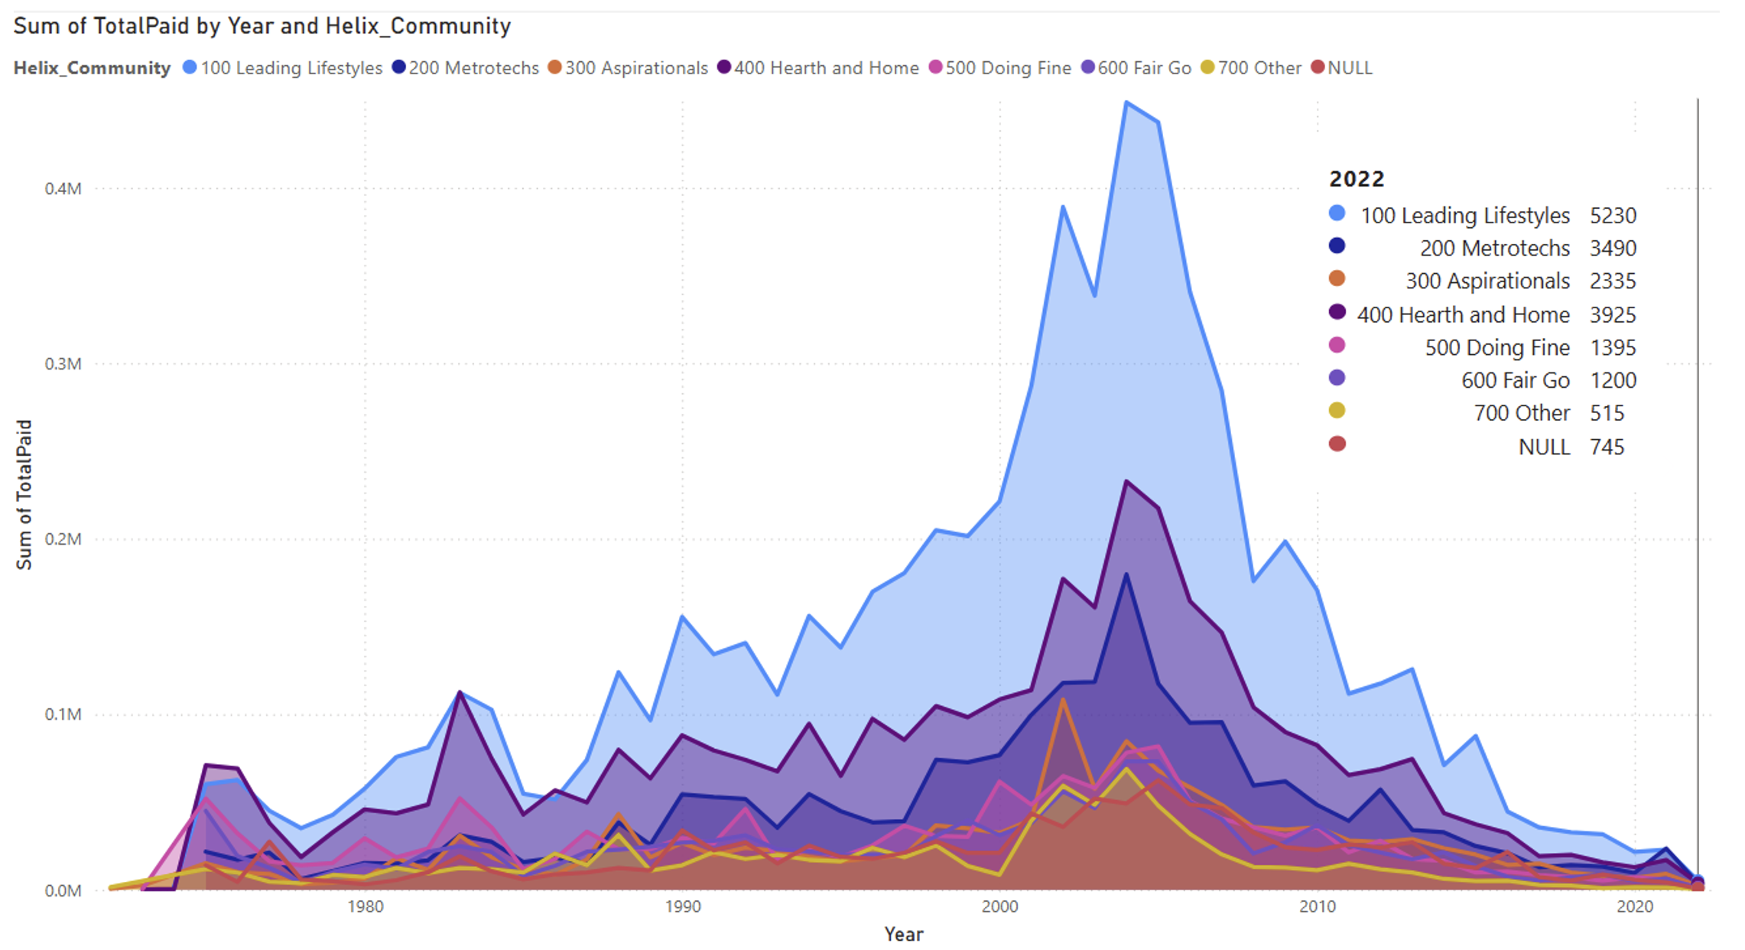

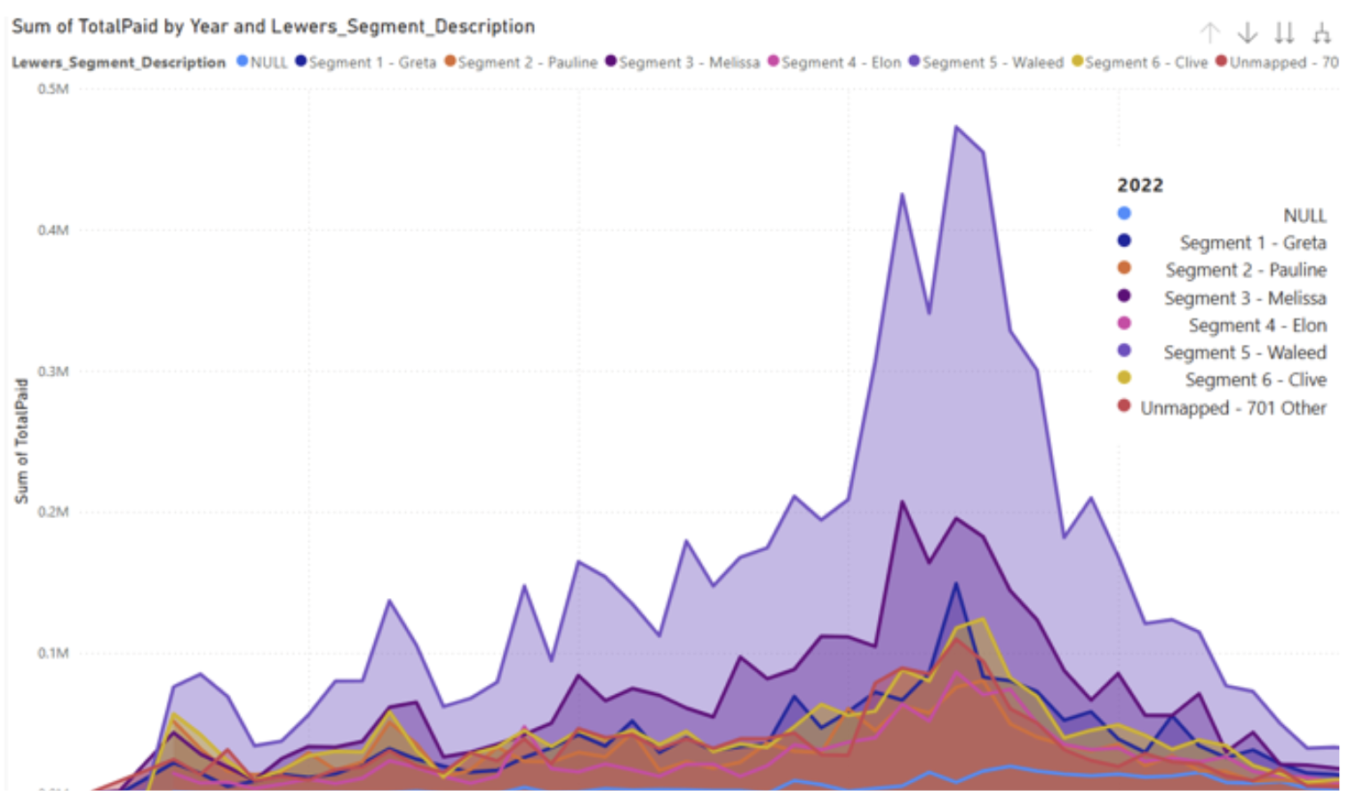
Channel Effectiveness – Contact vs Donor Outcomes
1
2
38% of contacts → 62% of donors (high conversion)
Direct Mail
3
Online:
Slightly underperforms
4
5
Others (SSG, Retail)
Underutilized with poor results
6
Direct Mail: Generates 73.3% of total revenue
Online: Brings in 24% with lower average donation size
Others: Minimal impact (<2% combined)

Slide 5

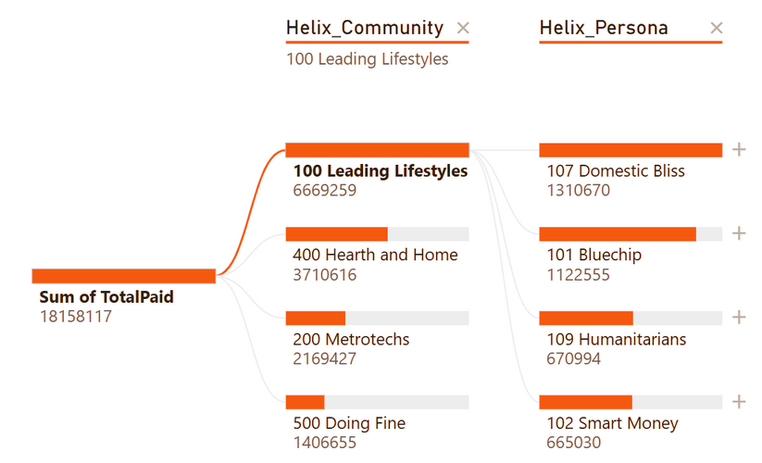
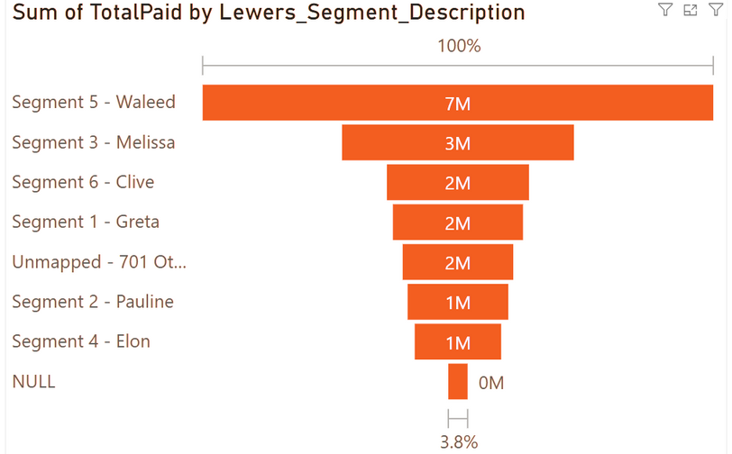
Donation Decline in best
performing Segments
1
Donation peaks around 2005–2010, followed by a clear and sustained decline through 2020s.
100 Leading Lifestyles dominates the chart (light blue area), contributing disproportionately to the donation total.
400 Hearth and Home is second-largest, with most other communities contributing minimally.
2
3
4
Channel Fatigue & Lack of
Segmentation Evolution
5
6
The steep decline in high-performing segments correlates with channel overuse.
Campaigns heavily relied on a few strong-performing segments, leaving others underdeveloped.
Could donor disengagement be a long-term trend and not a short-term fluctuation?
Action: Re-engage top segments with fresh, personalized strategies
“Leading Lifestyles” segment shows 35%+ drop since 2005

Slide 6
DECLINE IN DONATIONS FROM LEADING LIFESTYLES
1
2
Reasons include:
Channel fatigue
Over-targeting
Lack of message evolution
3
4
5
6
Action: Re-engage top segments with fresh, personalized strategies
“Leading Lifestyles” segment shows 35%+ drop since 2005

Slide 7

Data-Driven Actions to Improve Engagement
1
2
THANK YOU
Uniform Outreach Causing Fatigue
All segments have received the same campaign outreach without updates to segment-level insights, leading to donor fatigue—especially among top-performing segments, as seen in the donation decline since 2010.
Recommendation: Launch targeted campaigns for under-engaged
segments like Greta, Pauline, Clive, and Metrotechs & Doing Fine.
Over-Engagement of Top Segments
Segments such as Leading Lifestyles, Hearth and Home, Waleed, and Melissa show signs of fatigue due to excessive engagement.
Recommendation: Reduce outreach frequency from 7 to 3 times per year to prevent burnout and improve engagement.
Channel Imbalance in Outreach
“Outbound” channels dominate outreach, with Direct Mail ~(62%) and Online ~(36%) generating most donations. Other channels are underutilized.
Recommendation: Expand digital channel usage and test integrated campaigns that blend online and offline approaches to boost ROI.
3
4
5
6

Slide 8




THANK YOU

